Slide 1

KUET RESTAURANT
Presented By:
Suman Mia(Saikan)
Roll:1607045

Slide 2


Agenda Of KUET Restaurant:
1.Sign Up 6.Booking Restaurant
2.Login 7.Online Ordering
3.Home 8.Gallery
4.Menu 9.Logout
i.Chicken
ii.Snacks
iii.Burger
iv.Pizza
v.Pasta
vi.Rice Meals

Slide 3
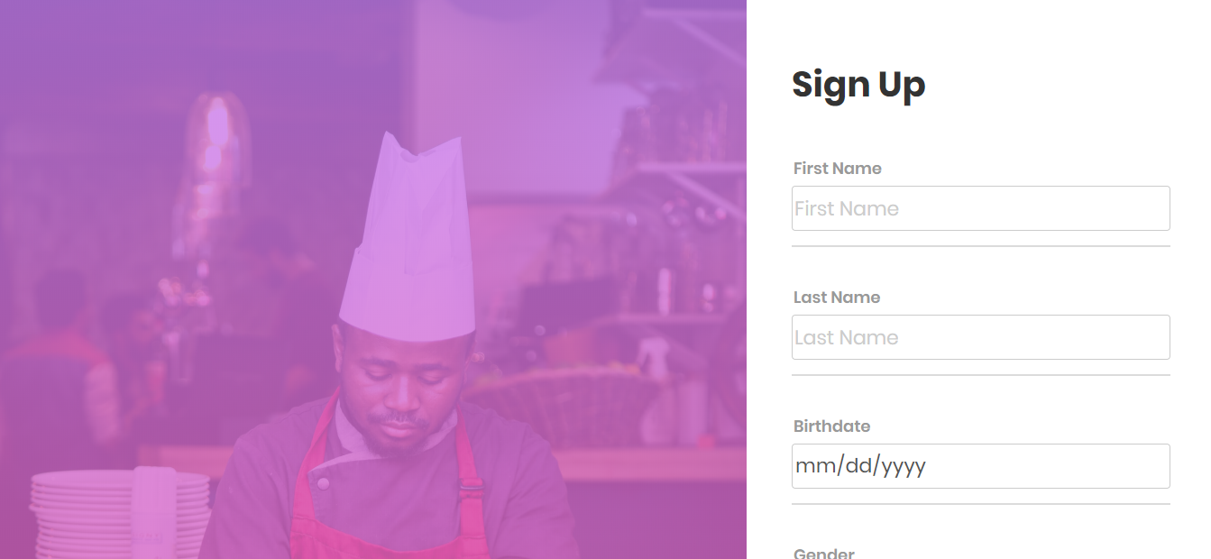
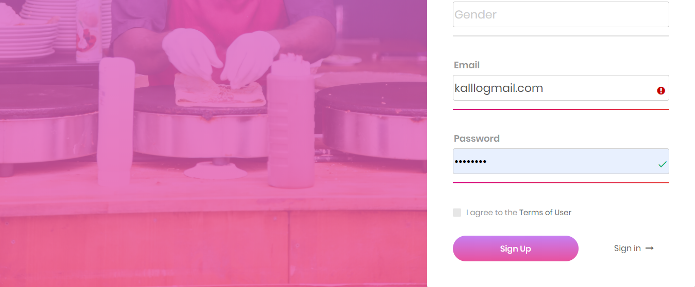

Slide 4
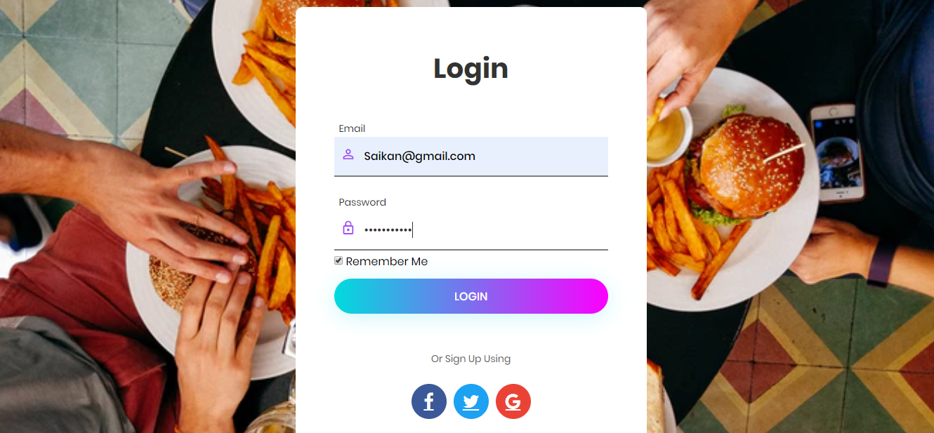

Slide 5
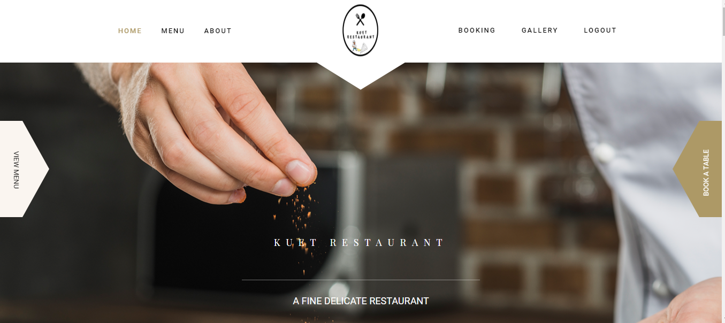
Home Page

Slide 6
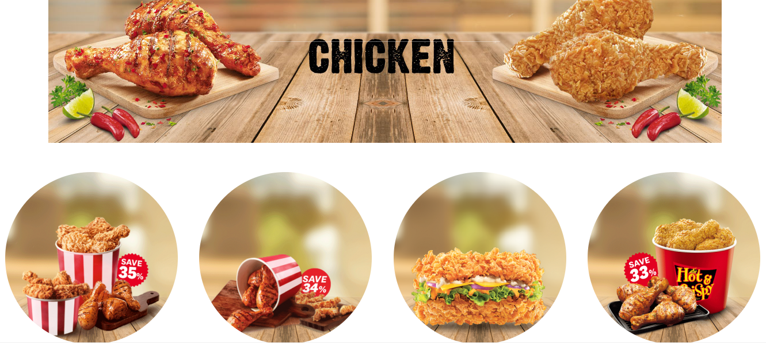
Menu Starts By Chicken

Slide 7
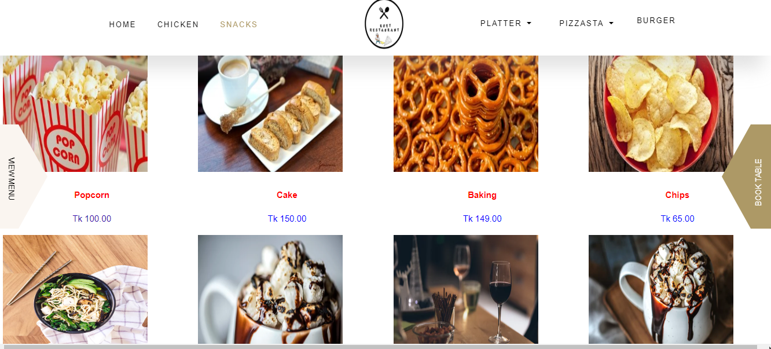
Snacks

Slide 8
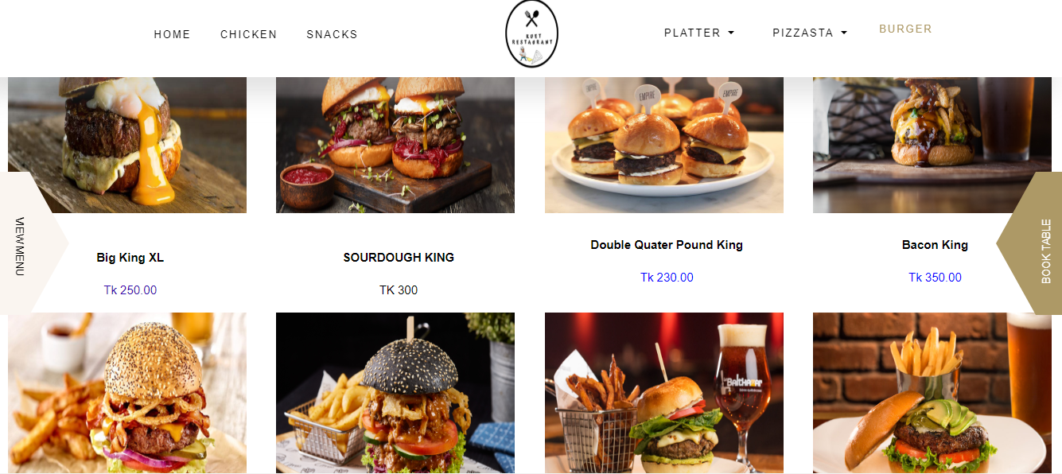
Burgers

Slide 9
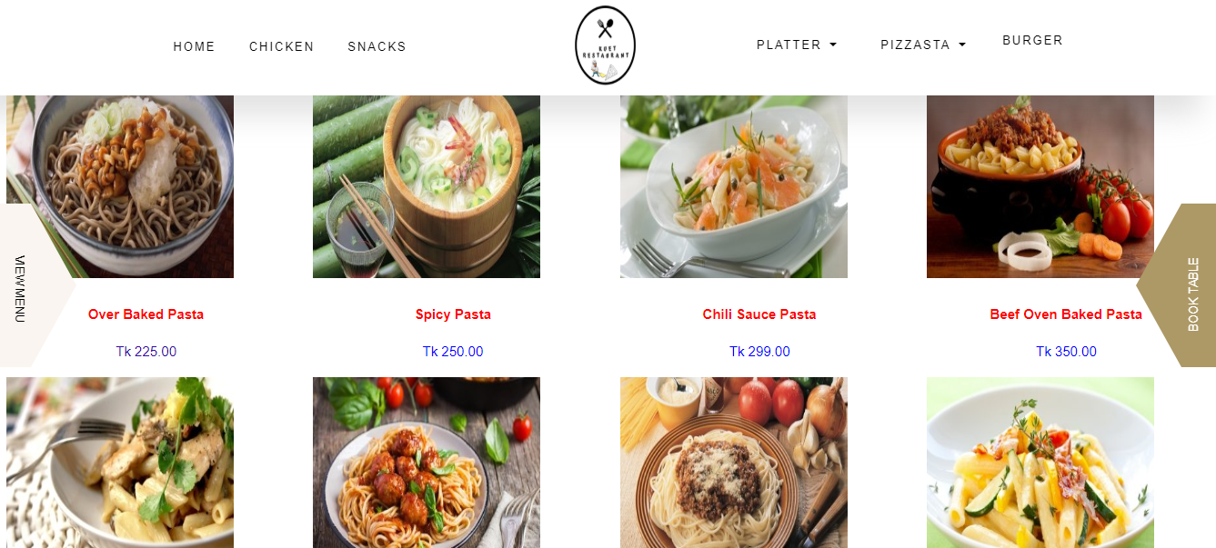
PASTA

Slide 10
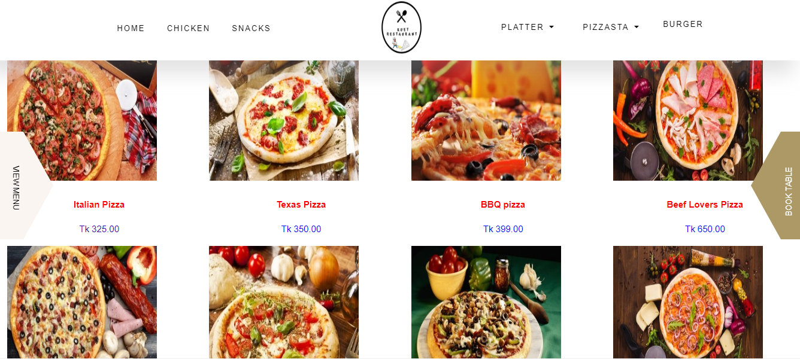
PIZZA

Slide 11
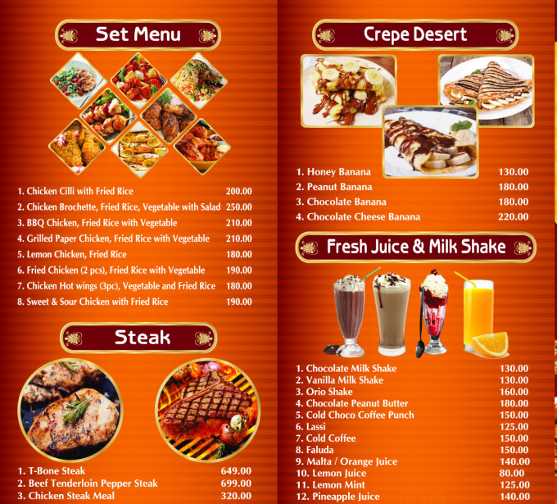
Rice Meal with Juice

Slide 12
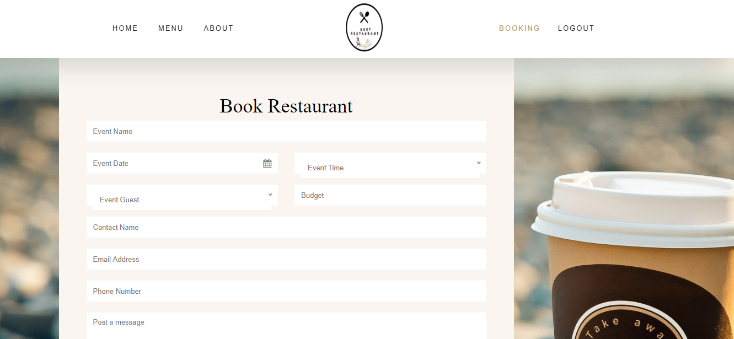
Booking For Event

Slide 13
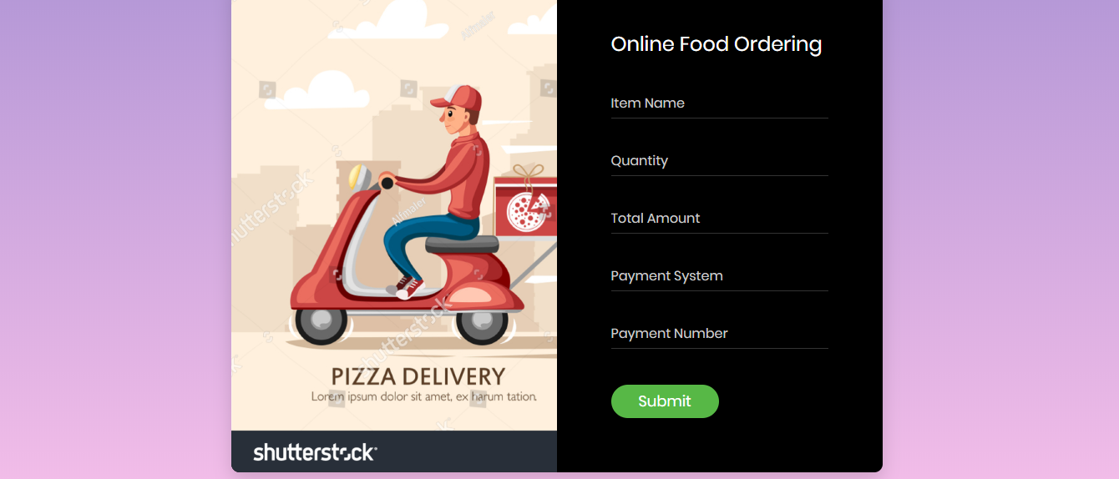
Online Food Ordering

Slide 14
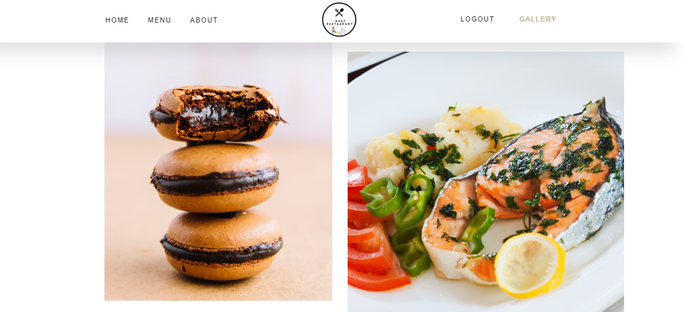
Gallery (Food and Restaurant Picture)

Slide 15
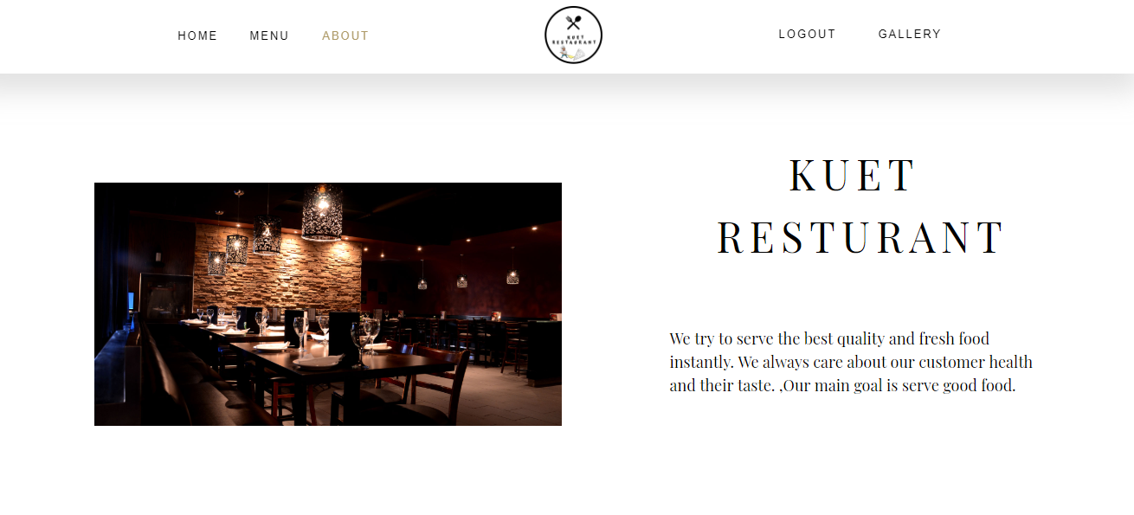
About & Contact

Slide 16




WHY OUR RESTAURANT?
TASTY FOOD
Online Ordering System
We always try to serve tasty and delicious food for customer.
Free Online delivery System For our Restaurant.
AMBIENCE
SPECIAL DRINKS
Nice ambience and atmosphere in our restaurant.

Slide 17


